Slide 1
Economic impacts
Methods for estimating total welfare impact
Monetary valuation
WTP v WTAC
Benefit transfer
Results and caveats
Climate v weather
Social cost of carbon
Distribution of impacts
Dynamic vulnerability
Schelling conjecture

Slide 2
Lectures
Science
Scenarios & emission reduction options
Costs of emission reduction
Instruments for emission reduction
Impacts of climate change & adaptation
Economic impacts of climate change
Climate and development
Optimal emission reduction
Discounting, uncertainty, equity
International environmental agreements

Slide 3
Economic impacts
Methods for estimating total welfare impact
Monetary valuation
WTP v WTAC
Benefit transfer
Results and caveats
Climate v weather
Social cost of carbon
Distribution of impacts
Dynamic vulnerability
Schelling conjecture

Slide 4
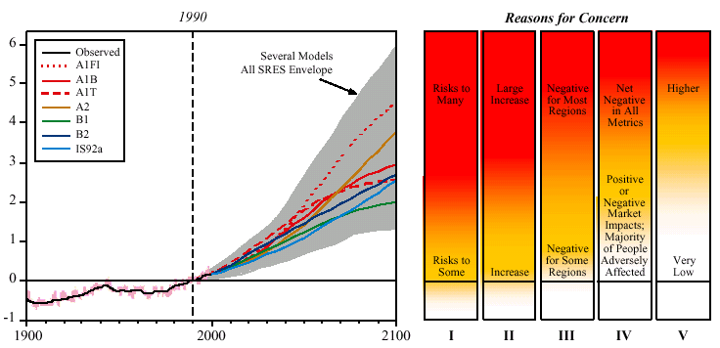
Global mean warming ºC
Year
I Risks to Unique and Threatened Systems
II Risks from Extreme Climate Events
III Distribution of Impacts
IV Aggregate Impacts
V Risks from Future Large-Scale Discontinuities
Source: IPCC 2001

Slide 5
Impacts of Climate
Climate change has many different impacts, with different effects for different countries, sectors, times
If one wants to get insights, high level indicators need to be used
If one wants to compare the impacts of climate change to the impacts of emission reduction, include the impacts in the national accounts, or determine how much compensation should be paid, money is the appropriate indicator

Slide 6
62 estimates in 39 papers

Slide 7

Methods
Enumerative method
Quantify impact, estimate price, add up
Computable general equilibrium
Quantify impact, shock model, estimate welfare change
Statistical method
Estimate relationship between activity and climate over space, assume it holds over time
Estimate relationship between well-being and climate
Elicitation method
Ask experts

Slide 8
Monetary Valuation
The aim is to express a welfare loss in an equivalent income loss
Revealed preferences
Travel cost
Hedonic pricing
Stated preferences
Contingent valuation
Contingent choice
Each method has its drawbacks, but stated preferences suffer from a range of biases, including unfamiliarity and manipulation

Slide 9
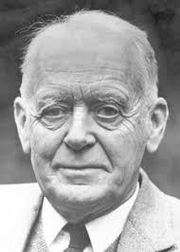



WTP v WTAC
Willingness to pay, or equivalent variation, is the maximum amount you would be willing to pay to secure a price fall
Willingness to accept compensation, or compensating variation, is the minimum amount you would be willing to accept to forego a price fall
Willig (1976) showed that
This is because of the income effect
He also showed that
This is because of substitution
Result carries over to quantities
$$EV<ΔCS<CV$$
$$EV≈ΔCS≈CV$$

Slide 10
WTAP / WTP

Slide 11
WTP and WTAC -2
Willingness to pay and willingness to accept compensation are different, because
the budget constraint is different
voluntary and involuntary risks are different
people attach value to the status quo
Relevant for climate because
willingness to pay for a better climate for our children and grandchildren
Our children’s and grandchildren’s willingness to accept compensation for us imposing a worse climate on them

Slide 12
Benefit transfer
Valuation is difficult and expensive
Therefore, estimated values are extrapolated (benefit transfer) from one place to the next and from one case to the next
As values are highly context-specific, this introduces all sorts of uncertainties, which are not well-understood

Slide 13
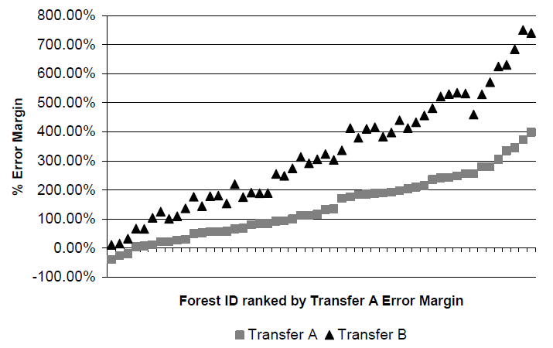

Slide 14
Area | Error (%)
Sport fishing | 5-40
 | 5-15
Water quality improvements | 4-34
 | 1-75
Water-based recreation | -
 | 1-475
Water quality improvements | 25-45
 | 18-41
Saltwater fishing | 1-34
 | -
White water rafting | 24-56
 | 6-228
Biodiversity on agricultural land | 27-36
 | 22-44

Slide 15
Economic impacts
Methods for estimating total welfare impact
Monetary valuation
WTP v WTAC
Benefit transfer
Results and caveats
Climate v weather
Social cost of carbon
Distribution of impacts
Dynamic vulnerability
Schelling conjecture

Slide 16
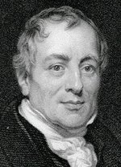
Methods
Enumerative method
Quantify impact, estimate price, add up
Computable general equilibrium
Quantify impact, shock model, estimate welfare change
Elicitation method
Ask experts
Statistical method
Estimate relationship between activity and climate over space, assume it holds over time
Estimate relationship between well-being and climate

Slide 17
Economic impacts
Methods for estimating total welfare impact
Monetary valuation
WTP v WTAC
Benefit transfer
Results and caveats
Climate v weather
Social cost of carbon
Distribution of impacts
Dynamic vulnerability
Schelling conjecture

Slide 19
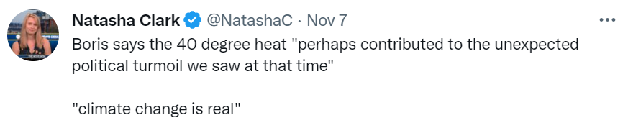

Slide 20
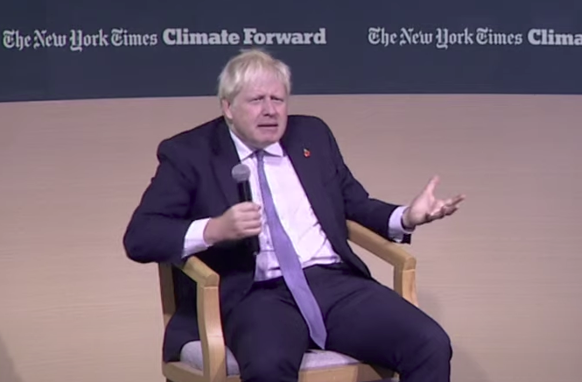

Slide 23
Caveats
Incomplete assessment
Interactions between impacts
Stylised adaptation
Low probability, high impact
Indirect impacts
Large-scale changes

Slide 25
Economic impacts
Methods for estimating total welfare impact
Monetary valuation
WTP v WTAC
Benefit transfer
Results and caveats
Climate v weather
Social cost of carbon
Distribution of impacts
Dynamic vulnerability
Schelling conjecture

Slide 26
Marginal Damage Costs
The marginal damage cost is the damage done by an additional tonne of CO2 emitted
It is the change in the net present value of the monetised impacts, normalised by the change in emissions
The marginal damage cost is the Pigou tax – it says how much we should spend on climate policy, by how much we should raise energy prices
It is a normative concept; it tells us what to do, given our values

Slide 27
Social cost of carbon
69 estimates of the total impact of climate change, 5397 estimates of its first partial derivative
Proliferation of estimates because
Total impact used to calibrate different impact curves
Different scenarios
Different climate models
Different carbon cycle models
Total impact hides regional, sectoral detail
Different views on how to aggregate over time, space and risk

Slide 29
Social cost of carbon
69 estimates of the total impact of climate change, 5397 estimates of its first partial derivative
Proliferation of estimates because
Total impact used to calibrate different impact curves
Different scenarios
Different climate models
Different carbon cycle models
Total impact hides regional, sectoral detail
Different views on how to aggregate over time, space and risk

Slide 31
Social cost of carbon
69 estimates of the total impact of climate change, 5397 estimates of its first partial derivative
Proliferation of estimates because
Total impact used to calibrate different impact curves
Different scenarios
Different climate models
Different carbon cycle models
Total impact hides regional, sectoral detail
Different views on how to aggregate over time, space and risk

Slide 32
Social cost of carbon
69 estimates of the total impact of climate change, 5397 estimates of its first partial derivative (in 207 papers)
Proliferation of estimates because
Total impact used to calibrate different impact curves
Different scenarios
Different climate models
Different carbon cycle models
Total impact hides regional, sectoral detail
Different views on how to aggregate over time, space and risk

Slide 33
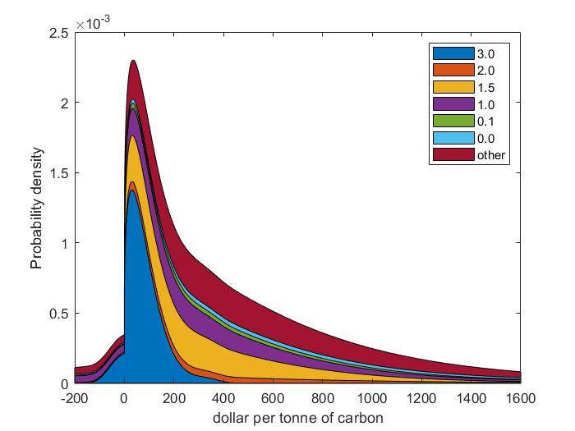

Slide 34
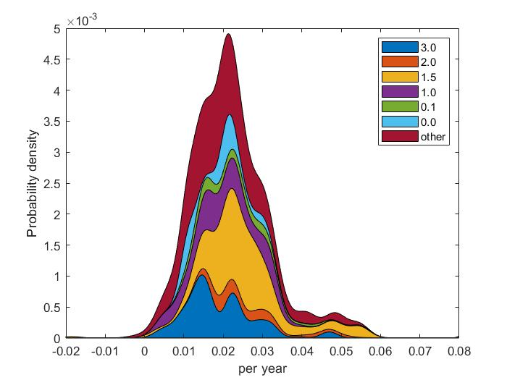

Slide 35
Economic Impact
Discussed impacts of climate change on welfare
Benefit of climate policy is the avoided impact
Uncertain, many assumptions
Mix of normative and positive elements

Slide 36


Slide 37
Economic impacts
Methods for estimating total welfare impact
Monetary valuation
WTP v WTAC
Benefit transfer
Results and caveats
Climate v weather
Social cost of carbon
Distribution of impacts
Dynamic vulnerability
Schelling conjecture

Slide 39
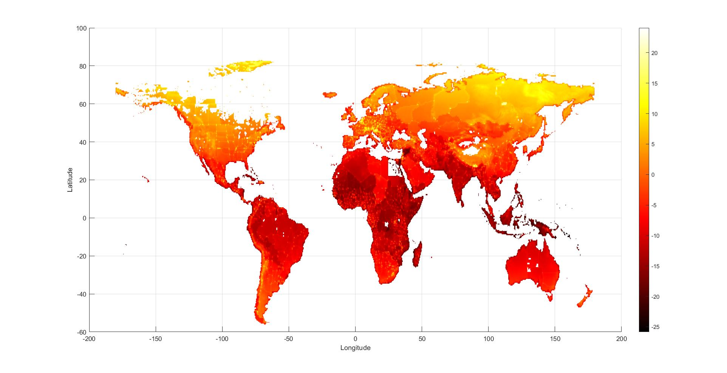

Slide 40
Poorer countries are more vulnerable as
More exposed

Slide 41
Poorer countries are more vulnerable as
More exposed
In hotter places

Slide 42
Poorer countries are more vulnerable as
More exposed
In hotter places
Lower adaptive capacity

Slide 43
Adaptive Capacity
Adaptive capacity is the ability to adapt
Adaptive capacity depends on
Available technological options
Available resources & their distribution
Ability and will to use those resources to protect people

Slide 44
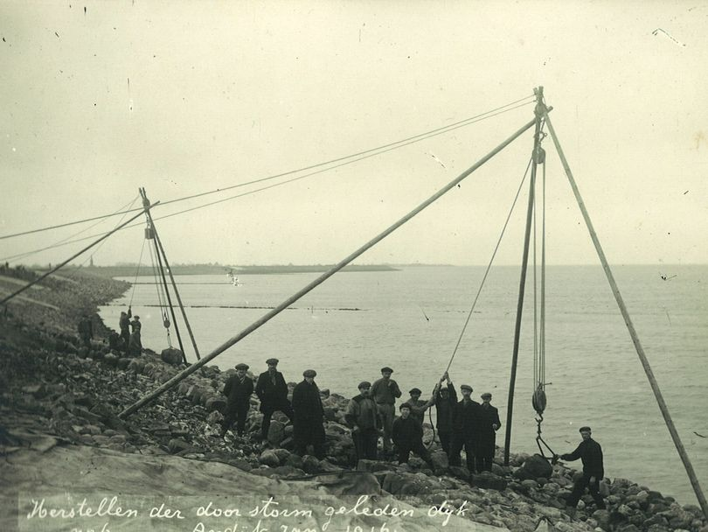
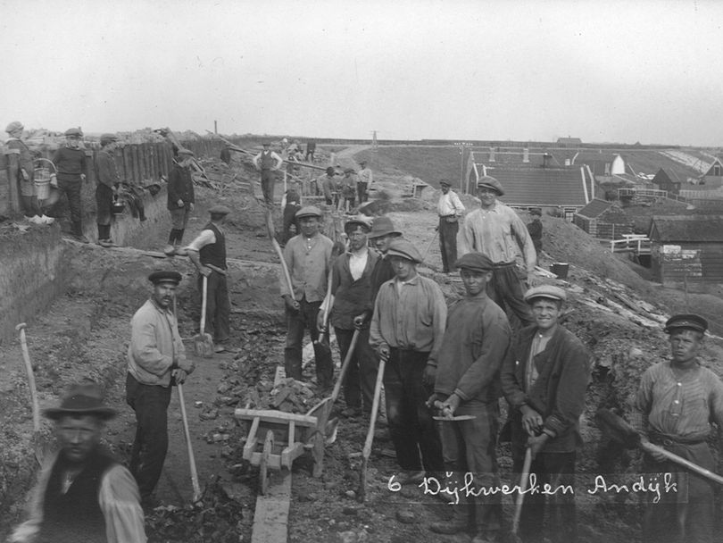
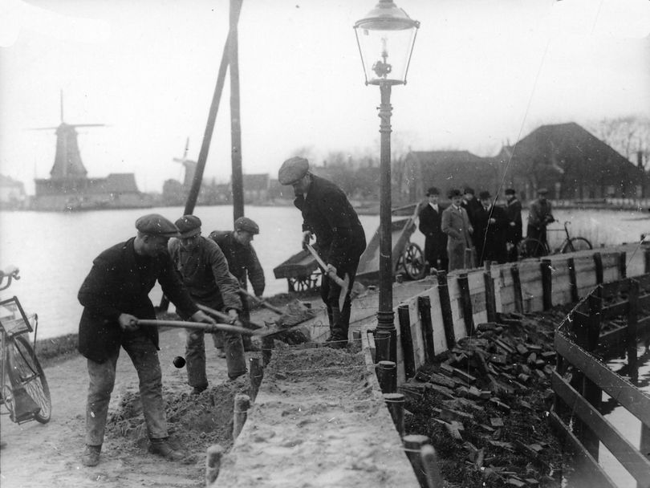
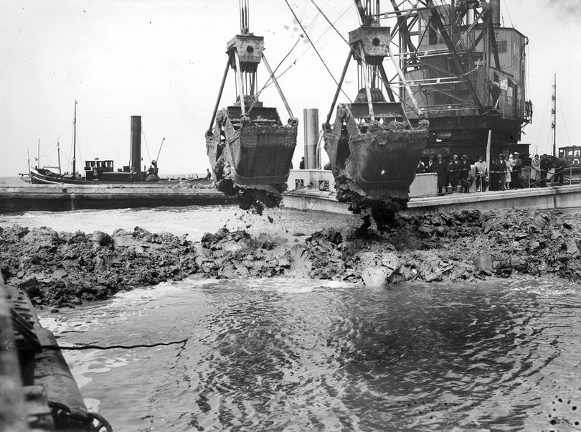
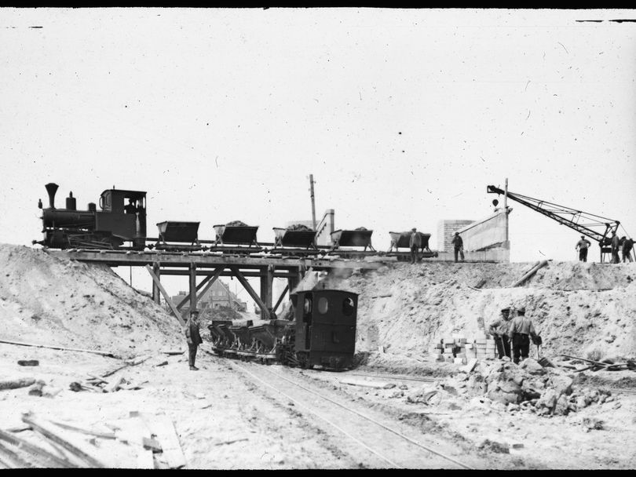
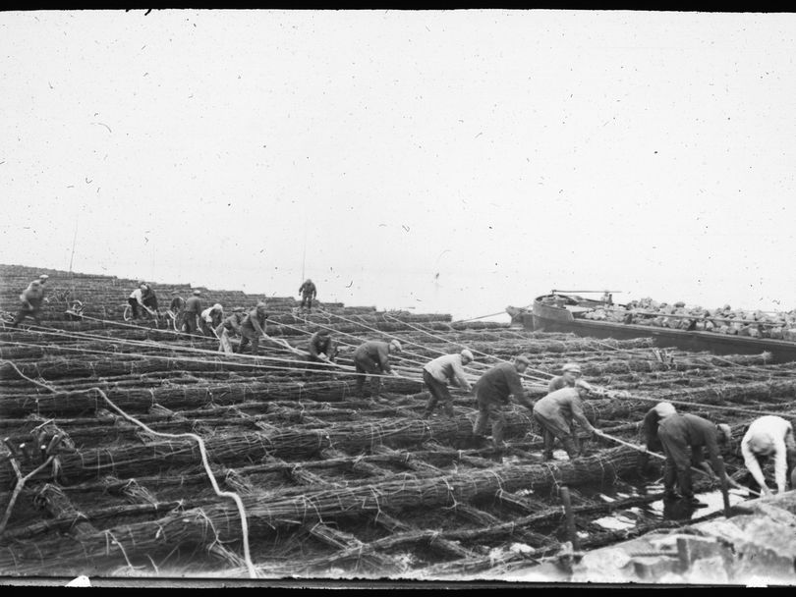
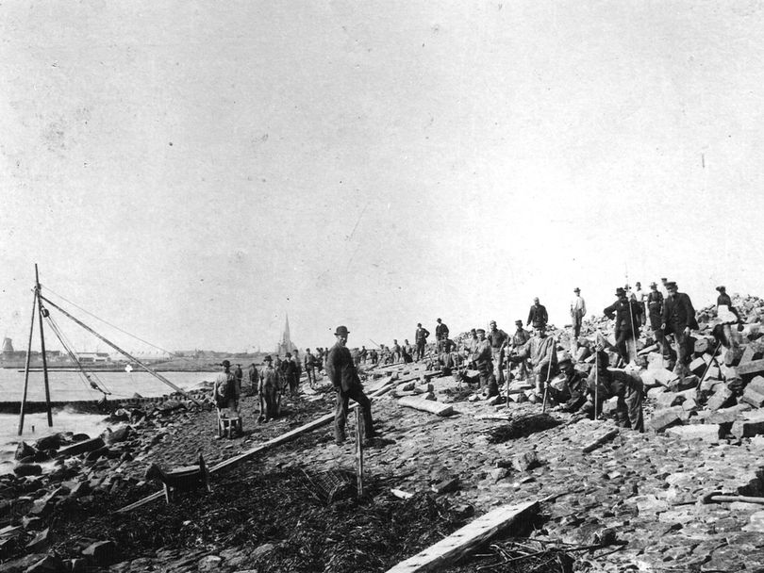

Slide 45
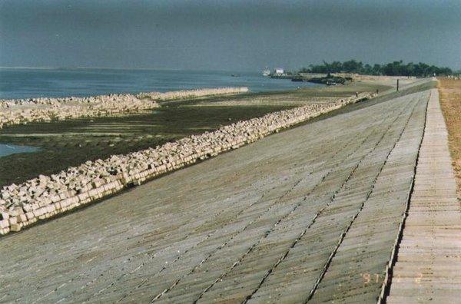
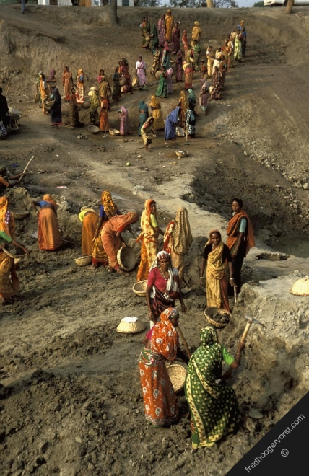
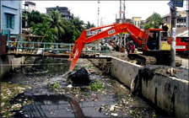
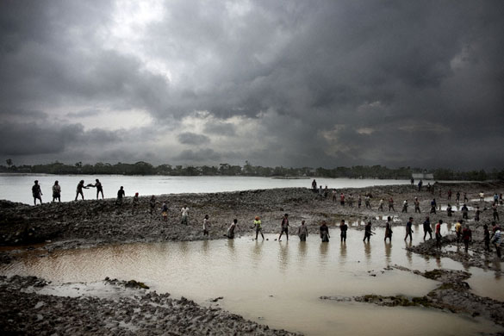
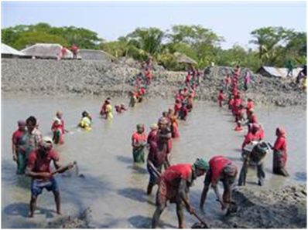

Slide 46
Bangladesh
Economically, Bangladesh is not far behind the Netherlands when it started its flood action plan
Technically, Bangladesh is far ahead
But
Corruption is terrible
Politics is antagonistic
Poor do not carry much weight in decision making
May think floods are a punishment by Allah rather than due to mismanagement by government

Slide 47
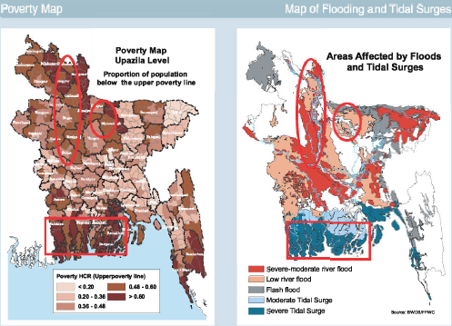

Slide 48
A brief history of the Netherlands
1848 European Spring
1849 Thorbecke Constitution
Central government
Broadly representative of population
1850 Modern dike building starts

Slide 50
Economic impacts
Methods for estimating total welfare impact
Monetary valuation
WTP v WTAC
Benefit transfer
Results and caveats
Climate v weather
Social cost of carbon
Distribution of impacts
Dynamic vulnerability
Schelling conjecture

Slide 51
Dynamics
Vulnerability to climate change is a function of exposure and adaptive capacity, both of which depend on development status
Future vulnerability will be very different from current vulnerability
Not only is future development uncertain, but also the link between development, exposure and adaptive capacity is unclear
I will illustrate this with the case of malaria

Slide 52
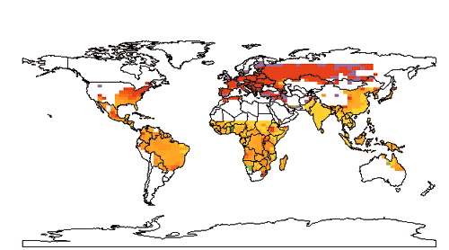
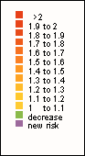

Slide 53
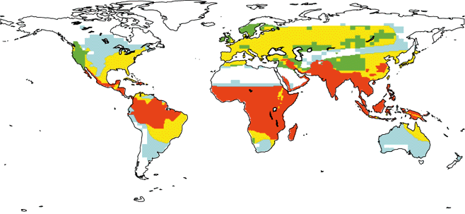
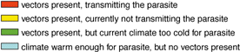

Slide 55
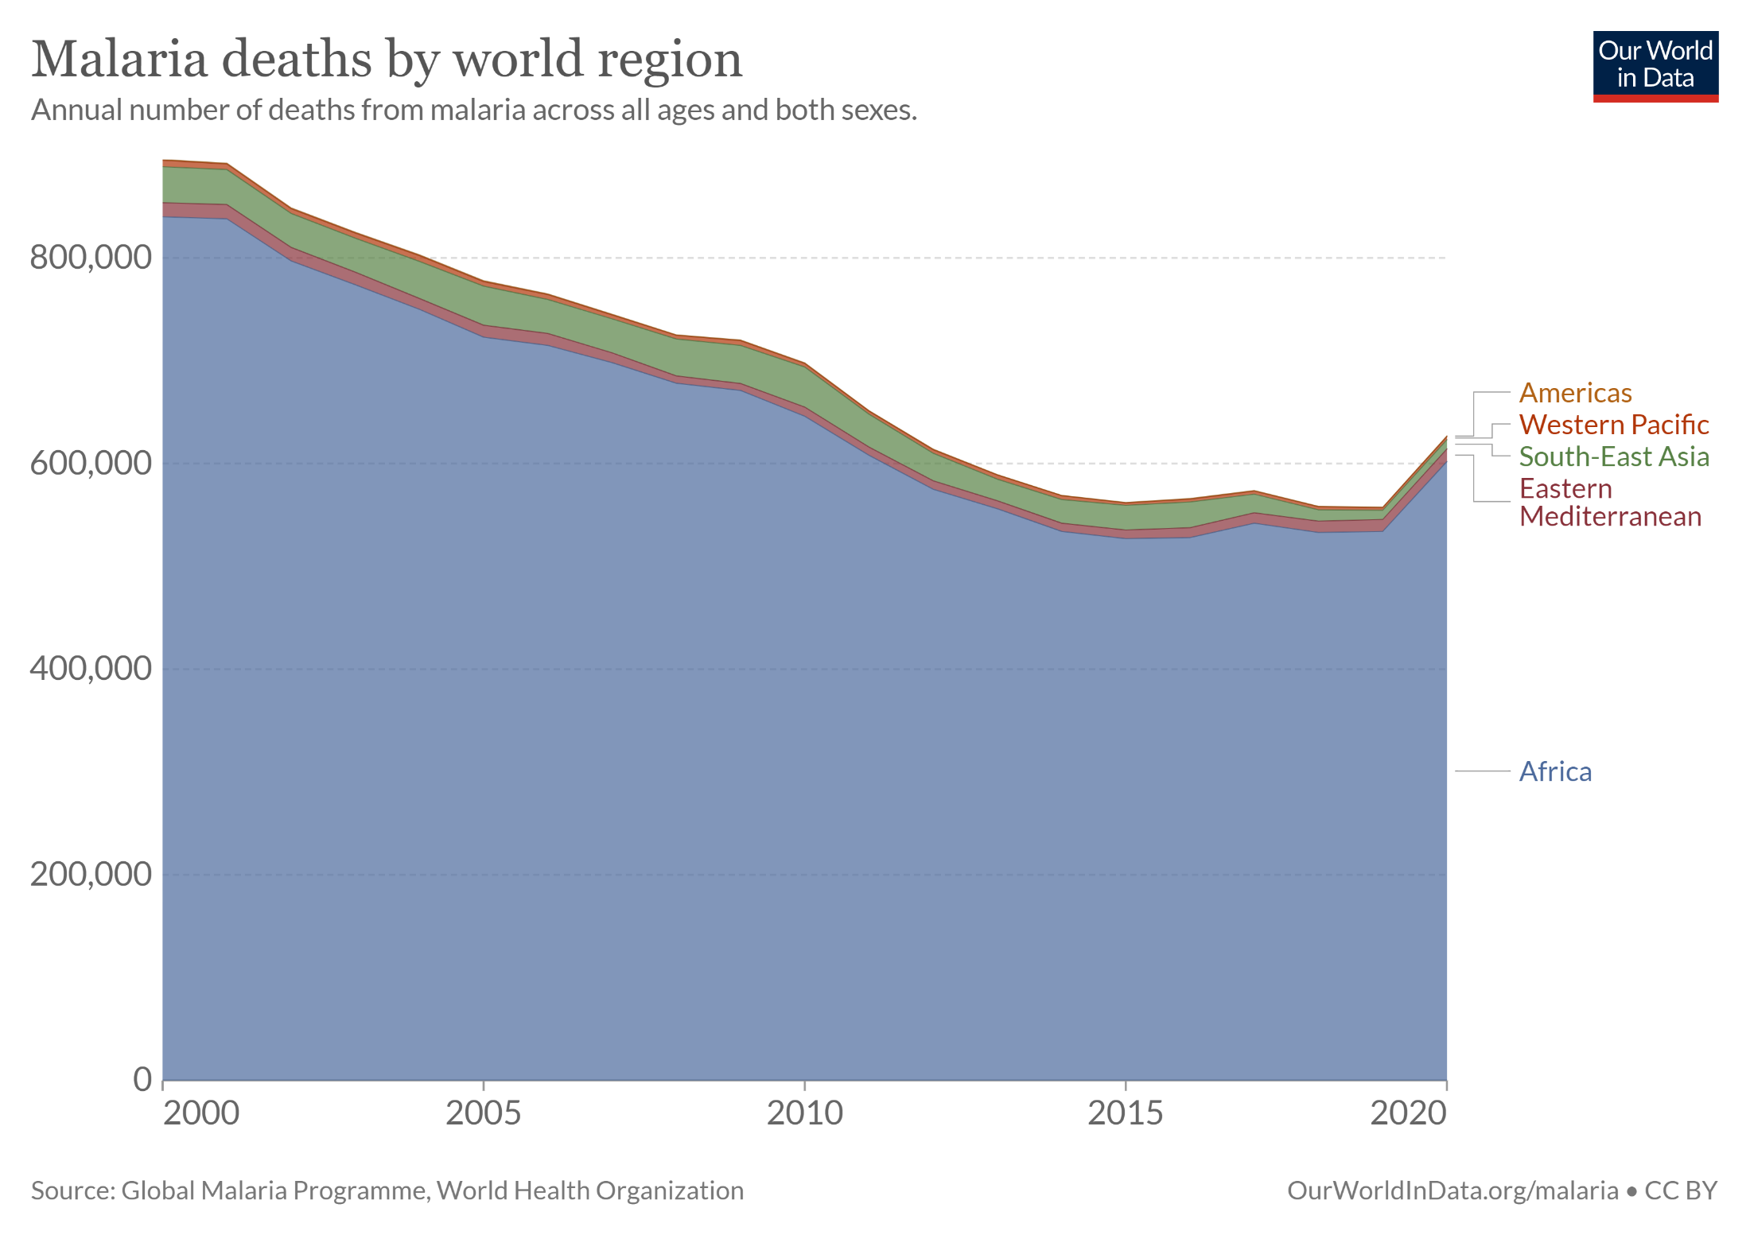

Slide 56
Economic impacts
Methods for estimating total welfare impact
Monetary valuation
WTP v WTAC
Benefit transfer
Results and caveats
Climate v weather
Social cost of carbon
Distribution of impacts
Dynamic vulnerability
Schelling conjecture

Slide 57
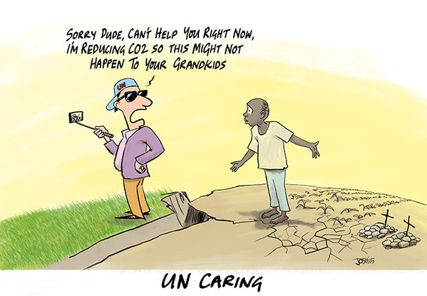
Schelling Conjecture
Nobel Laureate Tom Schelling asked
Why do we care about the grandchildren of people we do not seem to care about?

Slide 58
Schelling Conjecture
Nobel Laureate Tom Schelling asked
Why do we care about the grandchildren of people we do not seem to care about?
If we really do care about the impacts of climate change on the descendants of the current poor, are there better ways of helping them than through greenhouse gas emission reduction?
Is adaptation assistance a better way to reduce the impact of climate change?

Slide 59
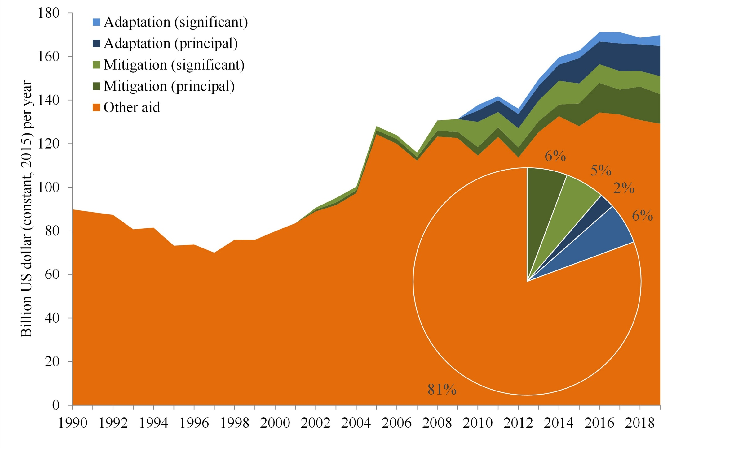

Slide 60
Schelling Conjecture -2
Is adaptation assistance a better way to reduce the impact of climate change?
Yes, if you could be sure to invent say a malaria vaccine if you invested enough, and would be sure it would use appropriately
Adaptive capacity is complex, however, and closely related to development
Development assistance has proven difficult

Slide 61
Schelling Conjecture -3
Besides, poverty implies vulnerability in general, but not always
Richer people
put higher values on health and environment
tend to live longer and thus develop cardiovascular diseases
might buy air conditioning that heats their environment

